Slide 1
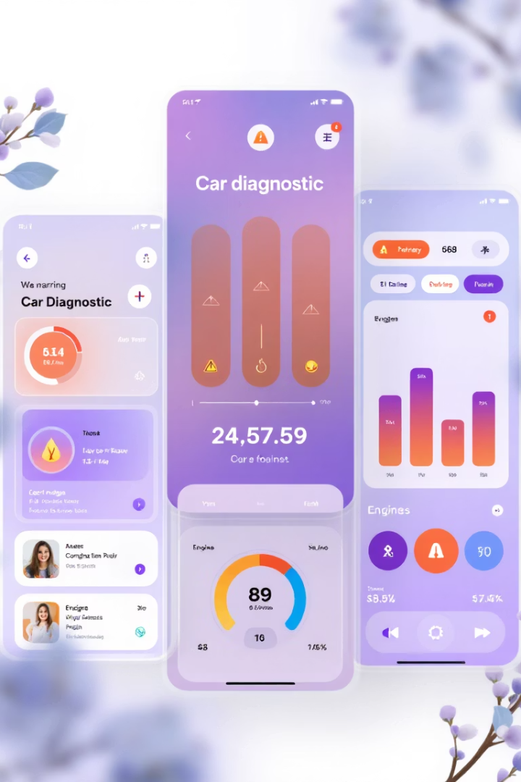

Database Design & Implementation for Car Fault Finder App
The Car Fault Finder app provides comprehensive vehicle diagnostic capabilities through both automatic (OBD-II) and manual methods. Our database design supports key features including dashboard light interpretation, audio-based fault detection, and maintenance tracking.
This presentation outlines our complete database architecture, from conceptual design through implementation, highlighting how we've structured data elements to support the app's core functionality while ensuring security and scalability.
by Group 18

Slide 2
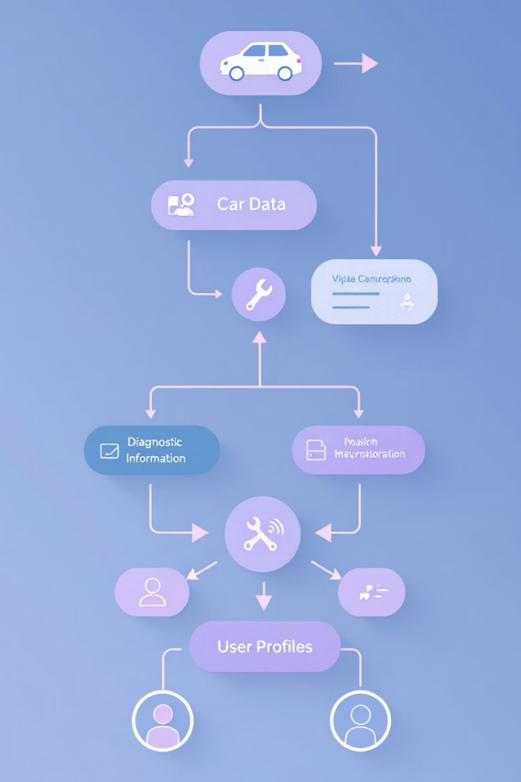
Data Elements Overview
Input Data
Data collected from users or external devices (OBD-II, audio recordings, camera images)
Output Data
Diagnostic results, repair recommendations, and tutorial links presented to users
Reference Data
Static information used for interpretation (OBD codes, sound classification models)
User Data
Profile information and interaction history to personalize the experience
Our data elements are categorized to efficiently support the app's diagnostic capabilities while maintaining a clear separation between user-generated content and reference information. This structure enables accurate fault detection across multiple input methods.

Slide 3





Conceptual Design & System Components
User Interface (Mobile App)
Front-end through which users interact with diagnostic tools and view results
Diagnostic Engine
Logic layer processing inputs from users, sensors, and ML models to generate results
Media Analysis Module
Camera and audio processing components for interpreting dashboard lights and engine sounds
Reference Services
Database of OBD-II codes, repair tutorials, and maintenance recommendations
Firebase Backend
Cloud infrastructure managing user data, diagnostics history, and media storage

Slide 4





Entity-Relationship Model
Our ER diagram defines the relationships between key entities in the system, establishing the foundation for database implementation.
User-Centered Design
Vehicle Data Structure
Each user can own multiple vehicles and initiate multiple diagnostic sessions, creating a personalized experience
Vehicle entities store make, model, year, and OBD support status, linking to maintenance records
Diagnostic Relationships
Maintenance Tracking
Diagnostic sessions connect to media inputs (images/audio) and produce results with recommendations
Maintenance tasks link to vehicles with timestamps, intervals, and reminder settings

Slide 5








Firebase Implementation
Scalable Cloud Solution
Supports growing user base and expanding feature set
Real-time Data Capabilities
Instant updates for diagnostic results and maintenance logs
Flutter Integration
Seamless connection between frontend and backend
Robust Security
Authentication and data protection built-in
We selected Firebase as our primary cloud platform due to its comprehensive suite of services that align perfectly with our application needs. Firebase provides a unified backend that handles authentication, data storage, file management, and cross-device synchronization with minimal configuration.

Slide 6
Database Schema Design
User Documents
Vehicle Collection
Maintenance Logs
Diagnostic Records
Profile information
Brand and model
Service date and type
Fault codes and descriptions
Authentication details
Year and specifications
Mileage and cost
Preferences
OBD-II compatibility
Service center information
Media references (images/audio)
Timestamp and location data
Our modular and extensible schema design enables efficient querying and management of user data while maintaining clear separation between different data types. This structure supports the app's core functionality while allowing for future expansion.

Slide 7








Key Features Implementation
Maintenance Book
Dashboard Scanning
Tracks service history with date, mileage, cost, and location data
Maps detected warning lights to explanations and recommendations
Vehicle Information
Engine Sound Analysis
Stores car details from the Autre-Other form for personalized experience
Records, stores, and compares engine sounds against reference files
Each feature is backed by specific Firestore collections and Firebase Storage components, with dedicated controllers handling CRUD operations based on user actions. This architecture ensures consistent data management across all app functions.

Slide 8
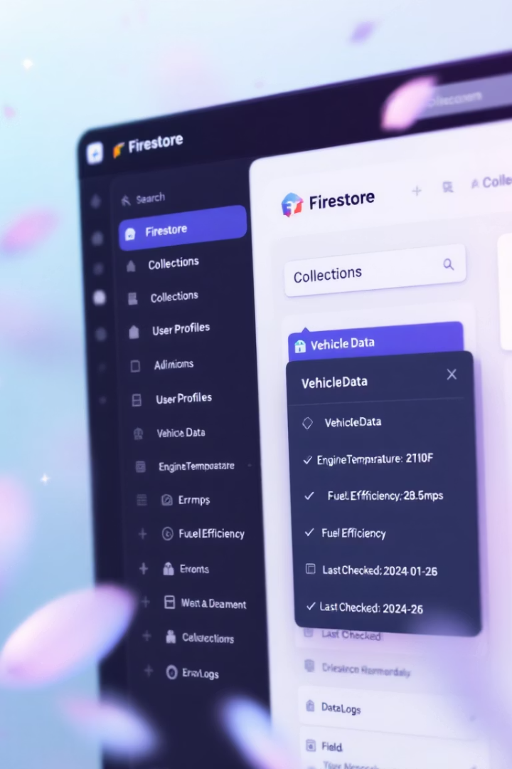
Backend Data Model Structure
Collection
Document ID
Key Fields
cars
userID/auto-generated
brand, model, email
recordings
userID/timestamp
userId, cloudURL, comparedResult
maintenance_logs
logID (auto-generated)
userId, carBrand, description, date
dashboard_scans
scanID (auto-generated)
userId, warningLight, description
Our Firestore structure organizes data into logical collections that mirror the app's functionality. Each document contains fields relevant to its purpose, with appropriate indexing on commonly queried fields to optimize performance.

Slide 9



Security & Performance Optimization
Authentication & Access Control
Firebase Authentication restricts data access to authorized users only
Security Rules
Custom Firestore rules protect sensitive data based on user IDs
Performance Tuning
Strategic indexing and local caching for frequently accessed data
We implemented comprehensive security measures to protect user data while ensuring optimal performance. Firebase Security Rules restrict access based on user authentication, while performance optimizations like batch operations and lazy loading improve responsiveness even with large datasets.

Slide 10





Conclusion & Future Enhancements
Comprehensive Solution
Our database design supports all core diagnostic features with a user-friendly structure
Scalable Architecture
Firebase implementation provides room for growth and feature expansion
Secure Data Management
Authentication and access controls protect sensitive vehicle and user information
Future Opportunities
AI-powered fault detection, maintenance reminders, and PDF export functionality
The Car Fault Finder app demonstrates how mobile and cloud technologies can create a practical, intelligent tool for automotive health management. Our database implementation provides the foundation for accurate diagnostics, enhanced user experience, and efficient vehicle maintenance.

